Slide 1
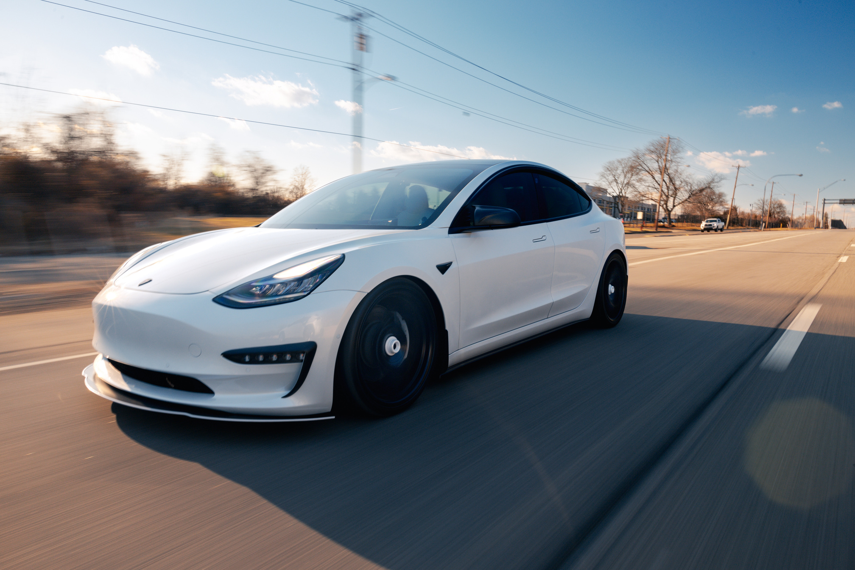

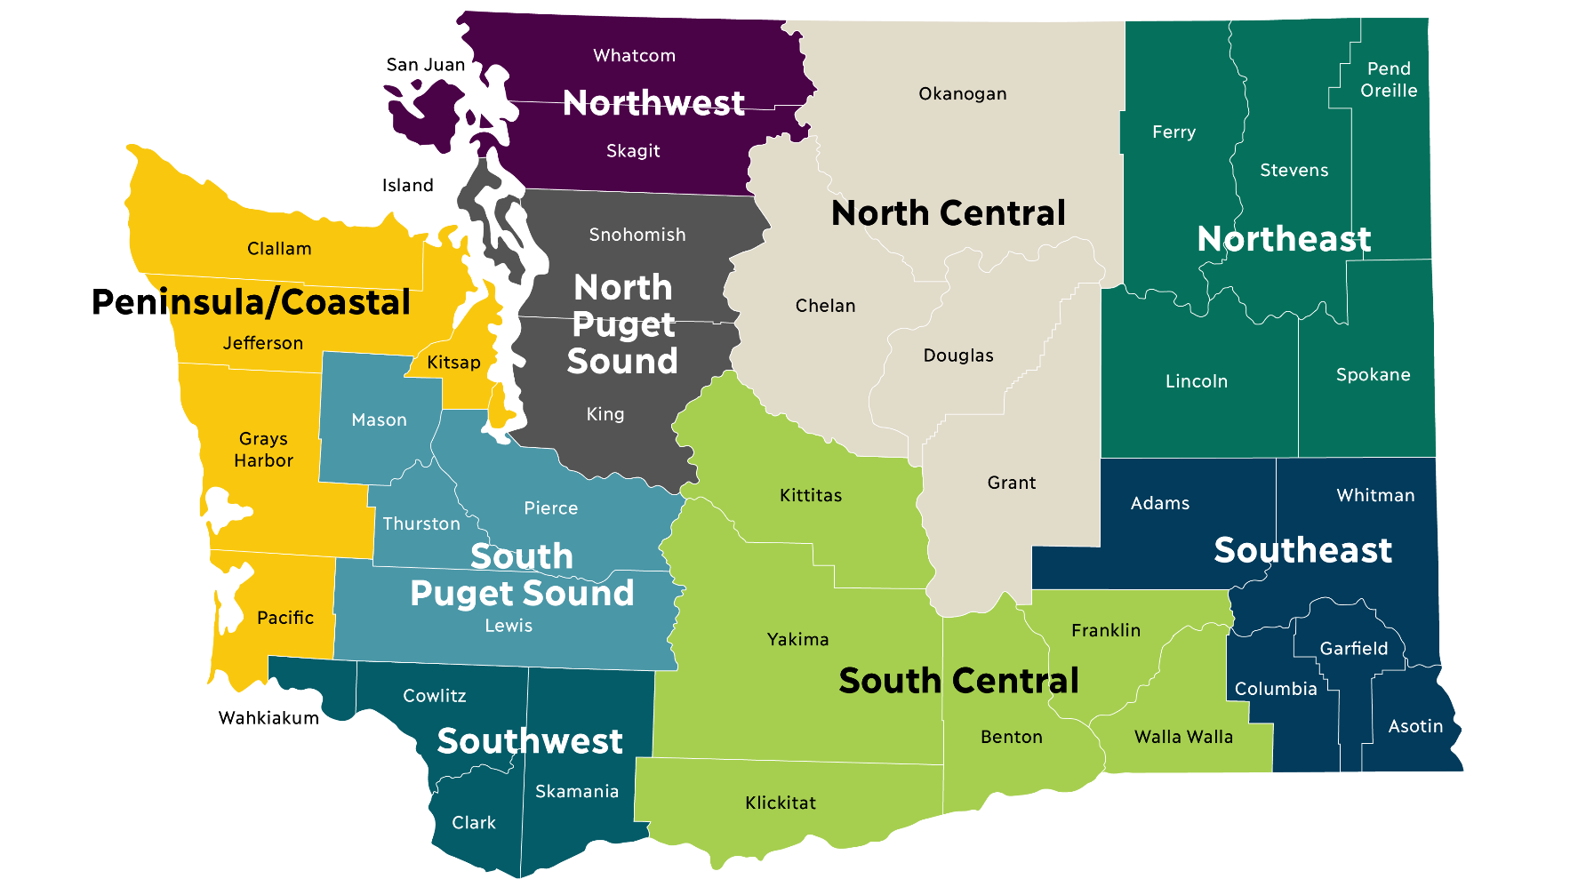
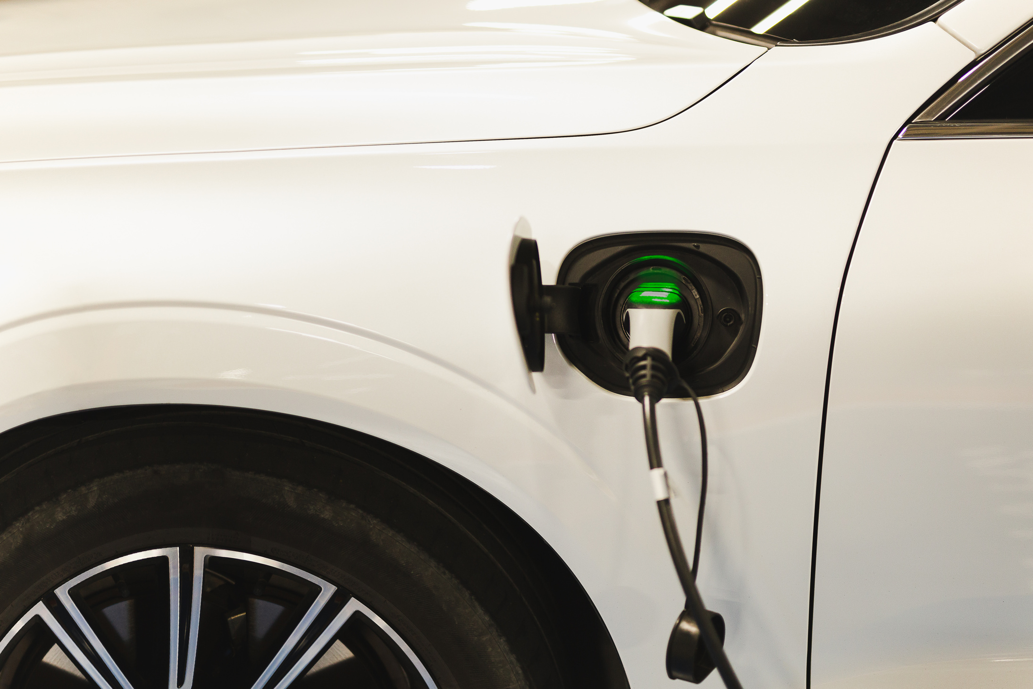
GA Capstone Project
EV Population Analysis in Washington State
Presented By:
Yusuf Aldamami

Slide 2

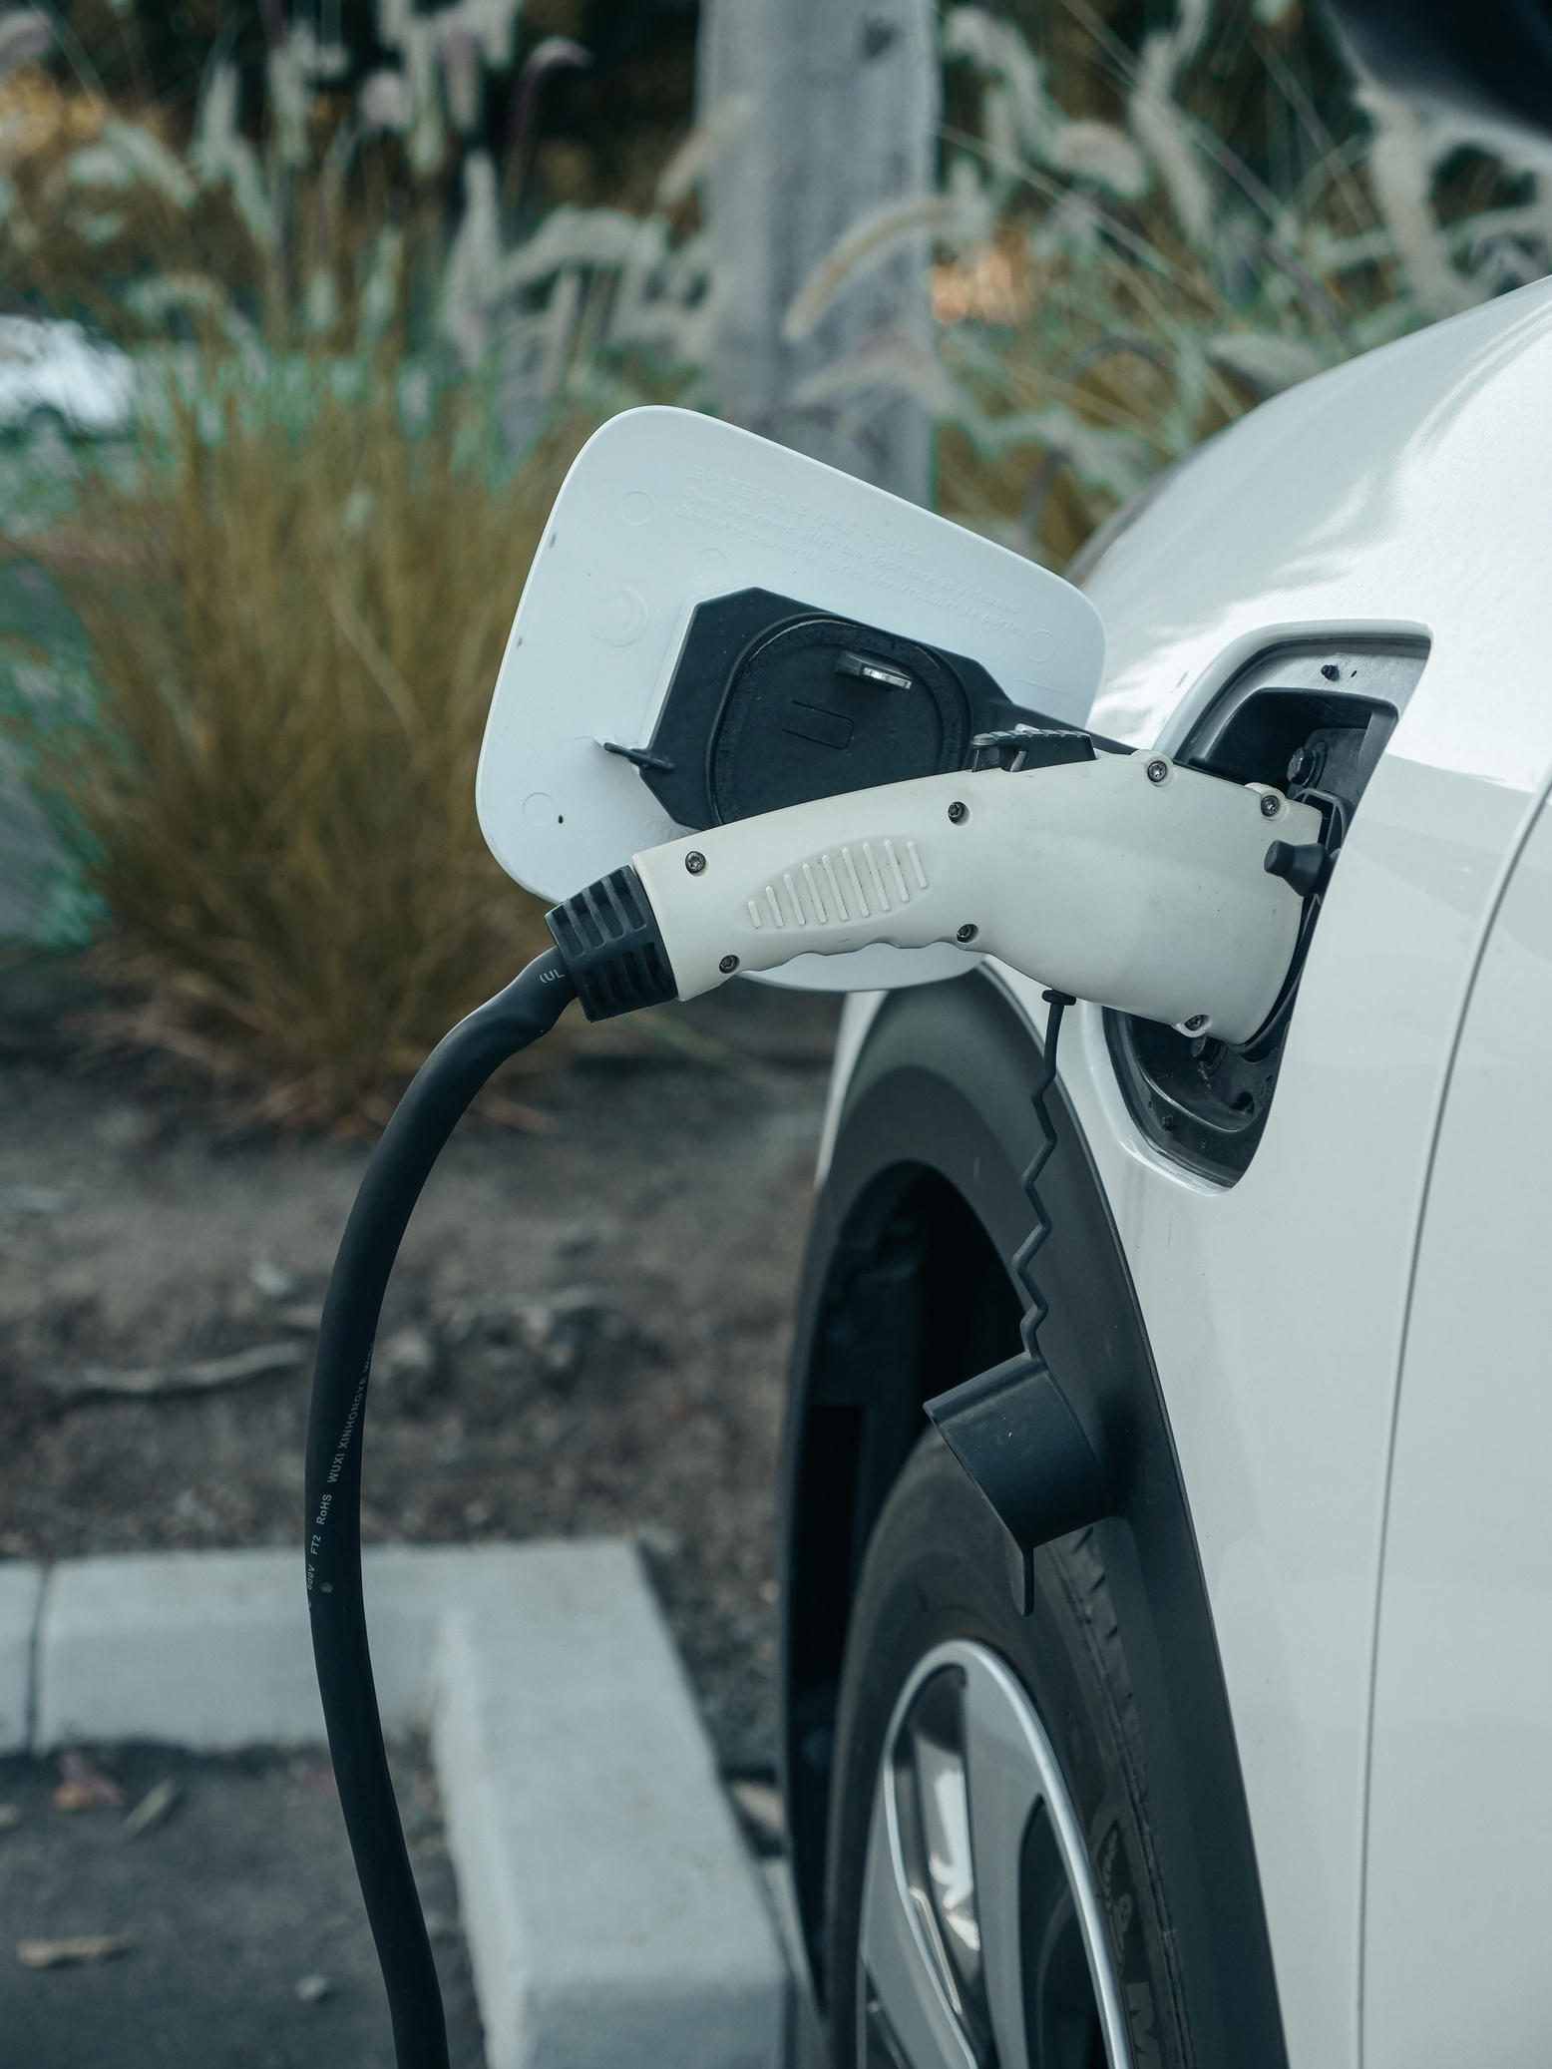

Powered by Electricity instead of gasoline or diesel.
About Electric Cars
lower operating costs, modern technology features
No exhaust, less pollution, supports a sustainable future.

Slide 3

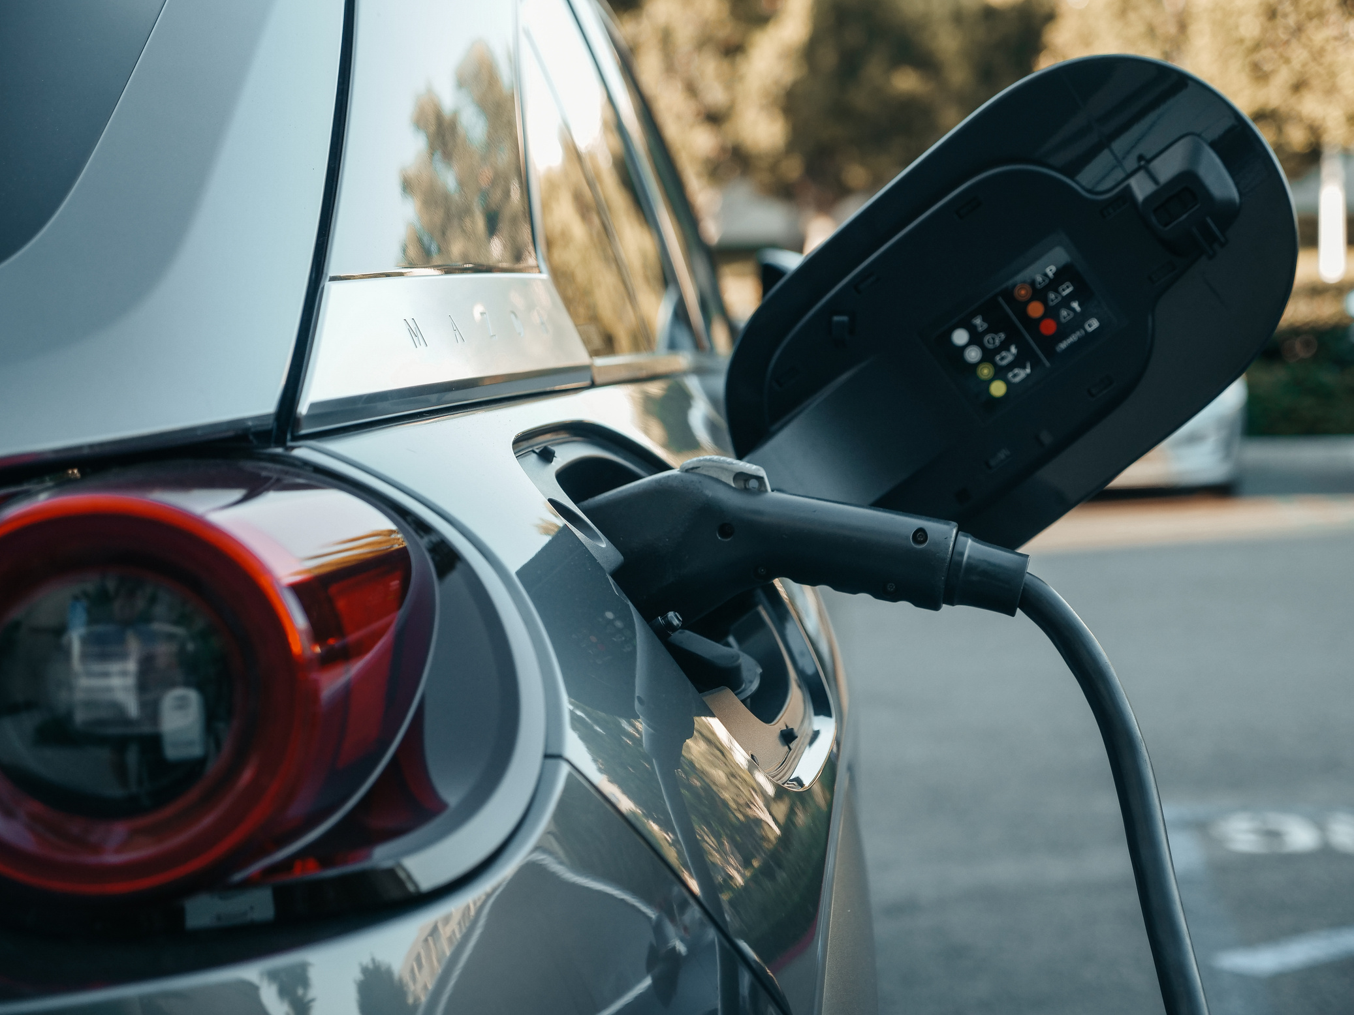
Problem Statement
As Washington State accelerates its transition to electric vehicles overall adoption continues to grow.
Yet adoption remains uneven with underserved counties falling behind due to unknown reasons.
The Washington State Department of Transportation has set a target to increase adoption in these regions by 15% before November 2026 to align with states sustainability goals.

Slide 4
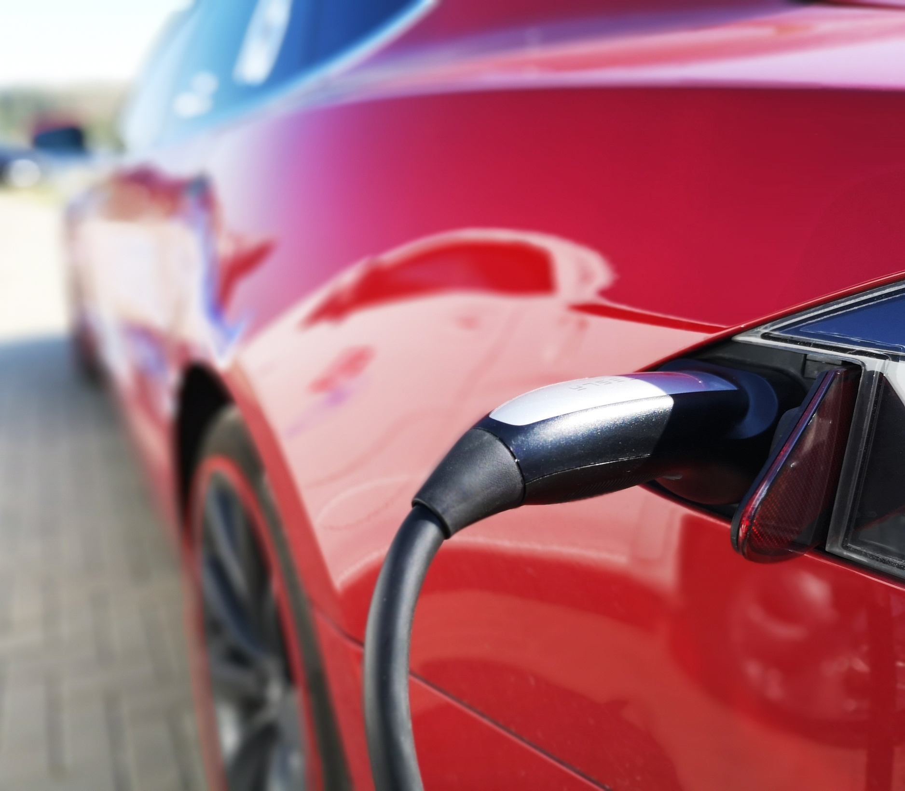
Aim
To analyze the distribution and characteristics of electric vehicles in Washington State to identify trends, highlight top Ev regions, and provide understanding of the Ev space for policymakers, utility companies, and businesses investing in EV infrastructure

Slide 5
Objectives
Measure EV adoption volumes and trends
Highlight policy and awareness challenges
Identify leading and underserved counties
Recommend investment priorities
Recommend investment priorities

Slide 6
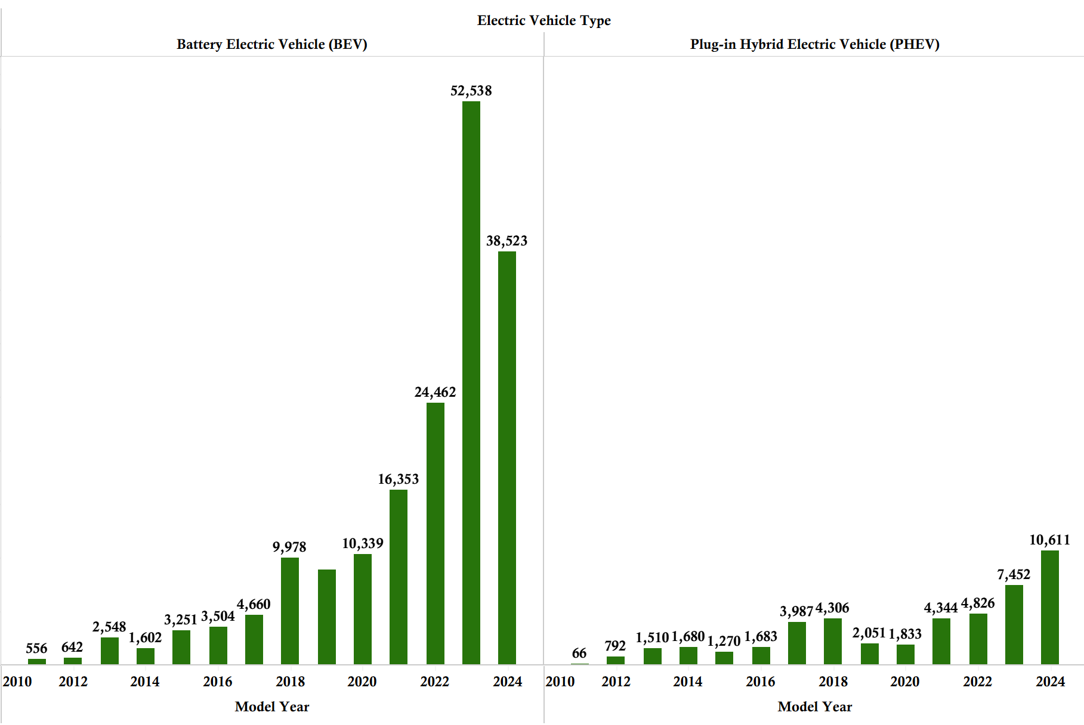
BEV vs PHEV
Fully electric battery powered vehicles consistently outnumber plug‑in hybrids across most years

Slide 7
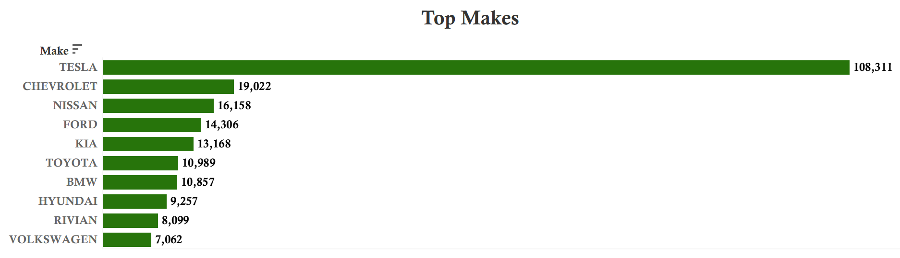
Dominant Car Brands
• The EV market is heavily concentrated with Tesla setting the pace followed by Chevrolet and Nissan.
• Brand familiarity, charging infrastructure and model variety seem to affect adoption.
• Urban counties with better infrastructure tend to favor Tesla’s.

Slide 8
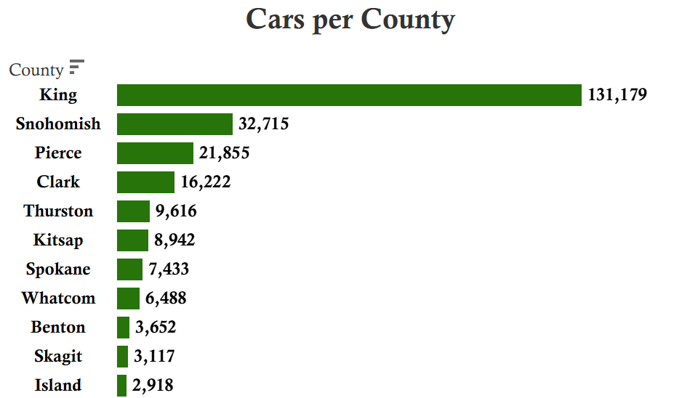
Top Performing Counties
Areas like King, Snohomish and pierce consistently show strong EV adoption due to a dense population and major cities being under them like Seattle.
Benefits from abundant charging stations and utility support
Higher income levels and access to Tax Credits incentives drive faster uptake compared to remote counties.

Slide 9
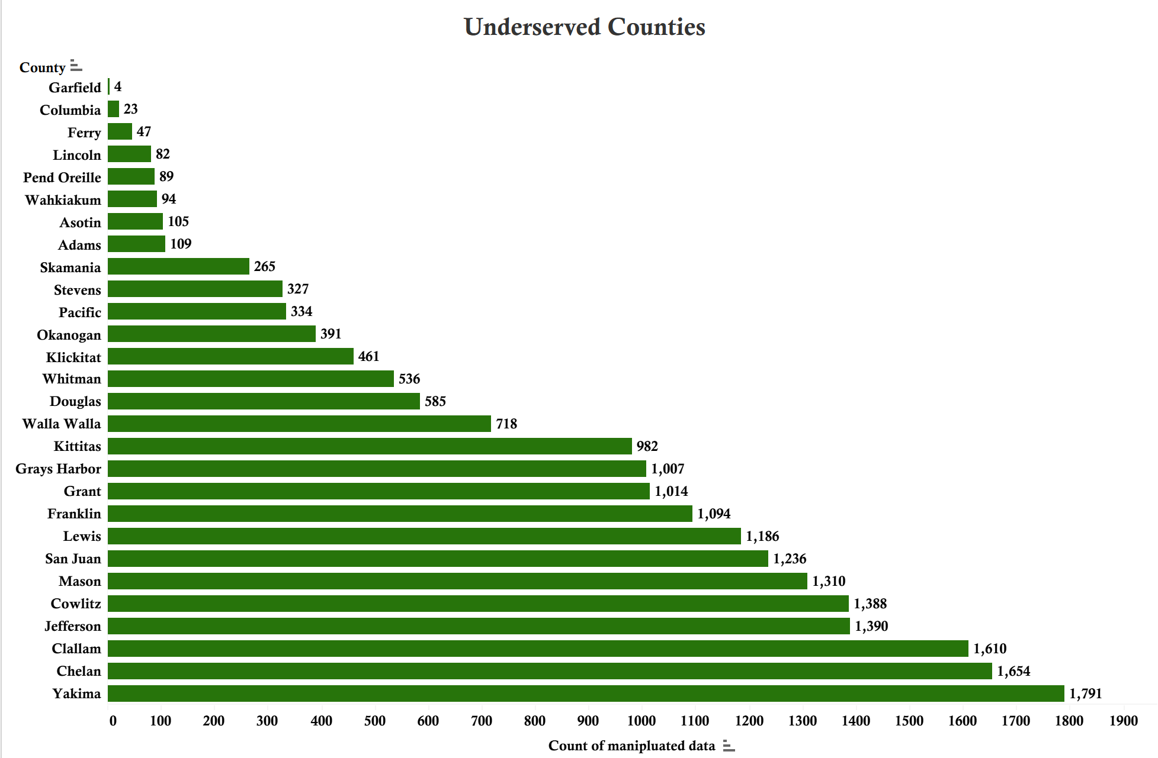
Underserved Regions
• Often located in very cold and remote areas, making infrastructure deployment more challenging
• Typically, colder with a smaller population and smaller access to charging stations

Slide 10
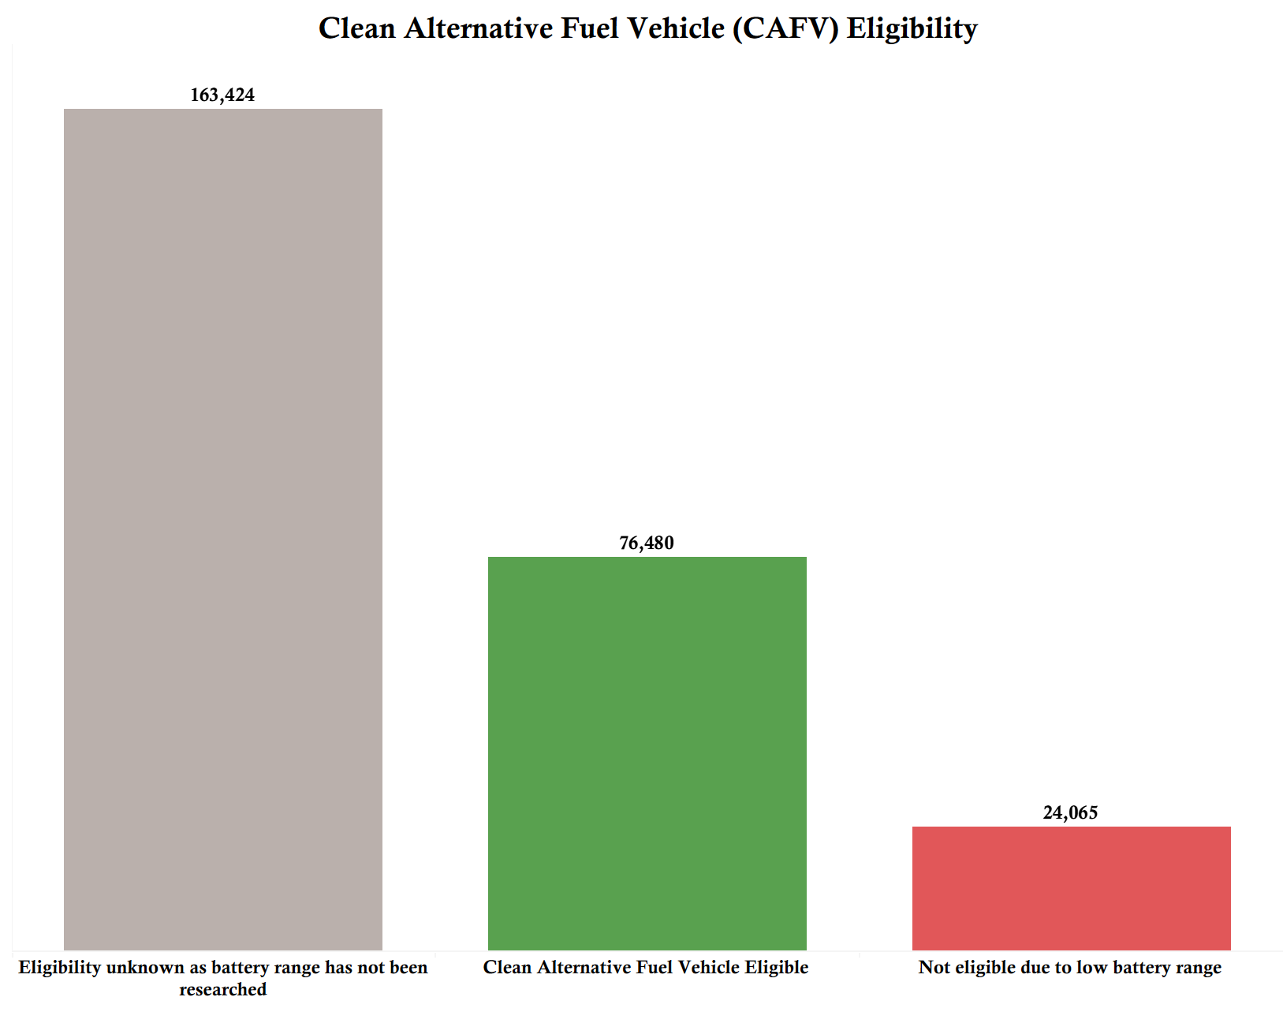
CAFV Eligibility
Measured based on type and electric range.
Determines access to incentives tax credits which reduces EV MSRP cost
Most vehicles show “Unknown,” a solid share are eligable and only a small percentage is not eligible.

Slide 11
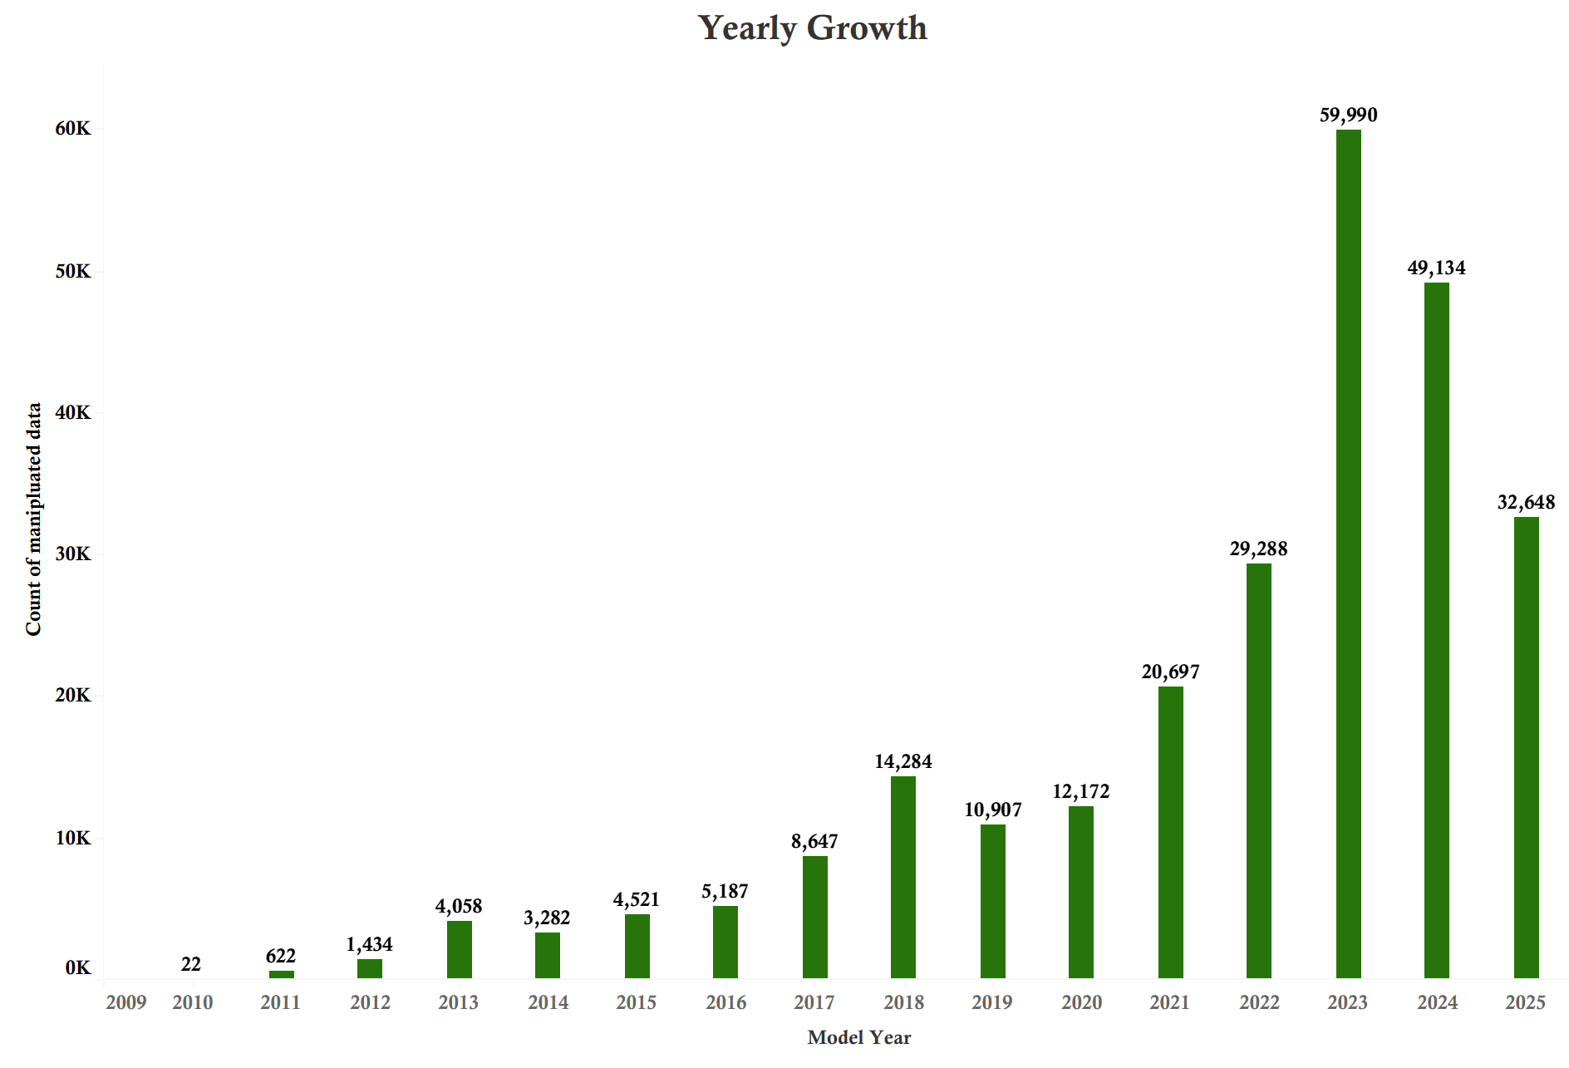
Model Year Trend
EV registrations in Washington State have grown dramatically since 2016, with a sharp surge from 2020 onward.
Peak Year is 2022 with almost 60k vehicles registered making it the highest growth to date.
Recent Dip in 2023 and 2024 show a slight decline, possibly due to market saturation, supply chain shifts, or policy transitions.

Slide 12
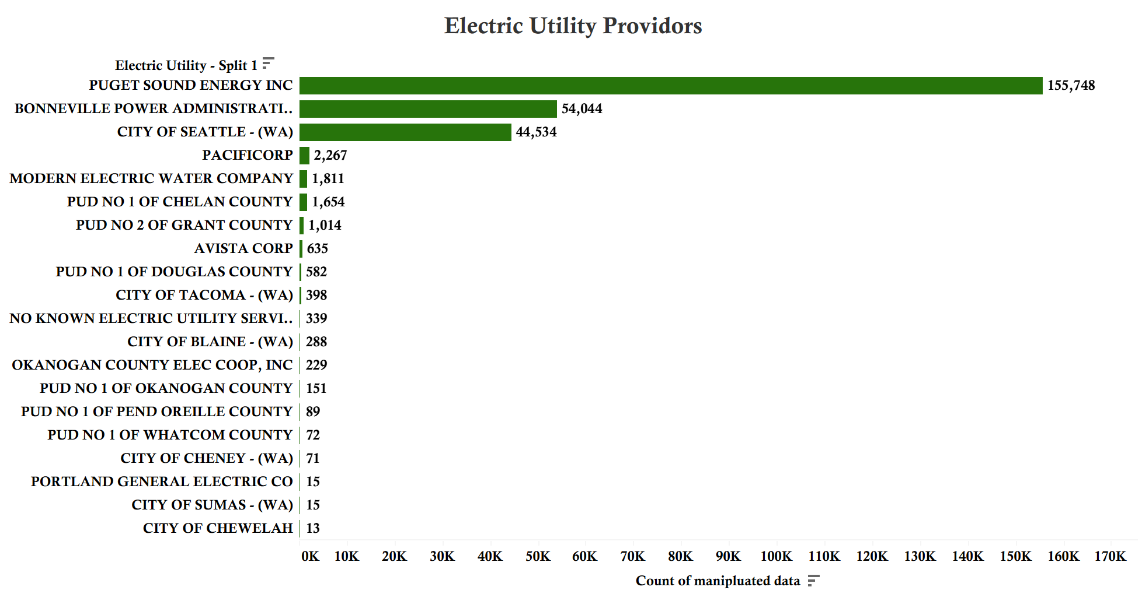
Charging Station Providers
Puget Sound Energy dominates with over 155k EVs rely on Puget Sound Energy for charging making it the state’s most critical utility for EV infrastructure.
Bonneville Power Administration and City of Seattle serve tens of thousands of EVs, showing strong urban coverage.
Smaller providers support niche regions often in remote or underserved areas.

Slide 13
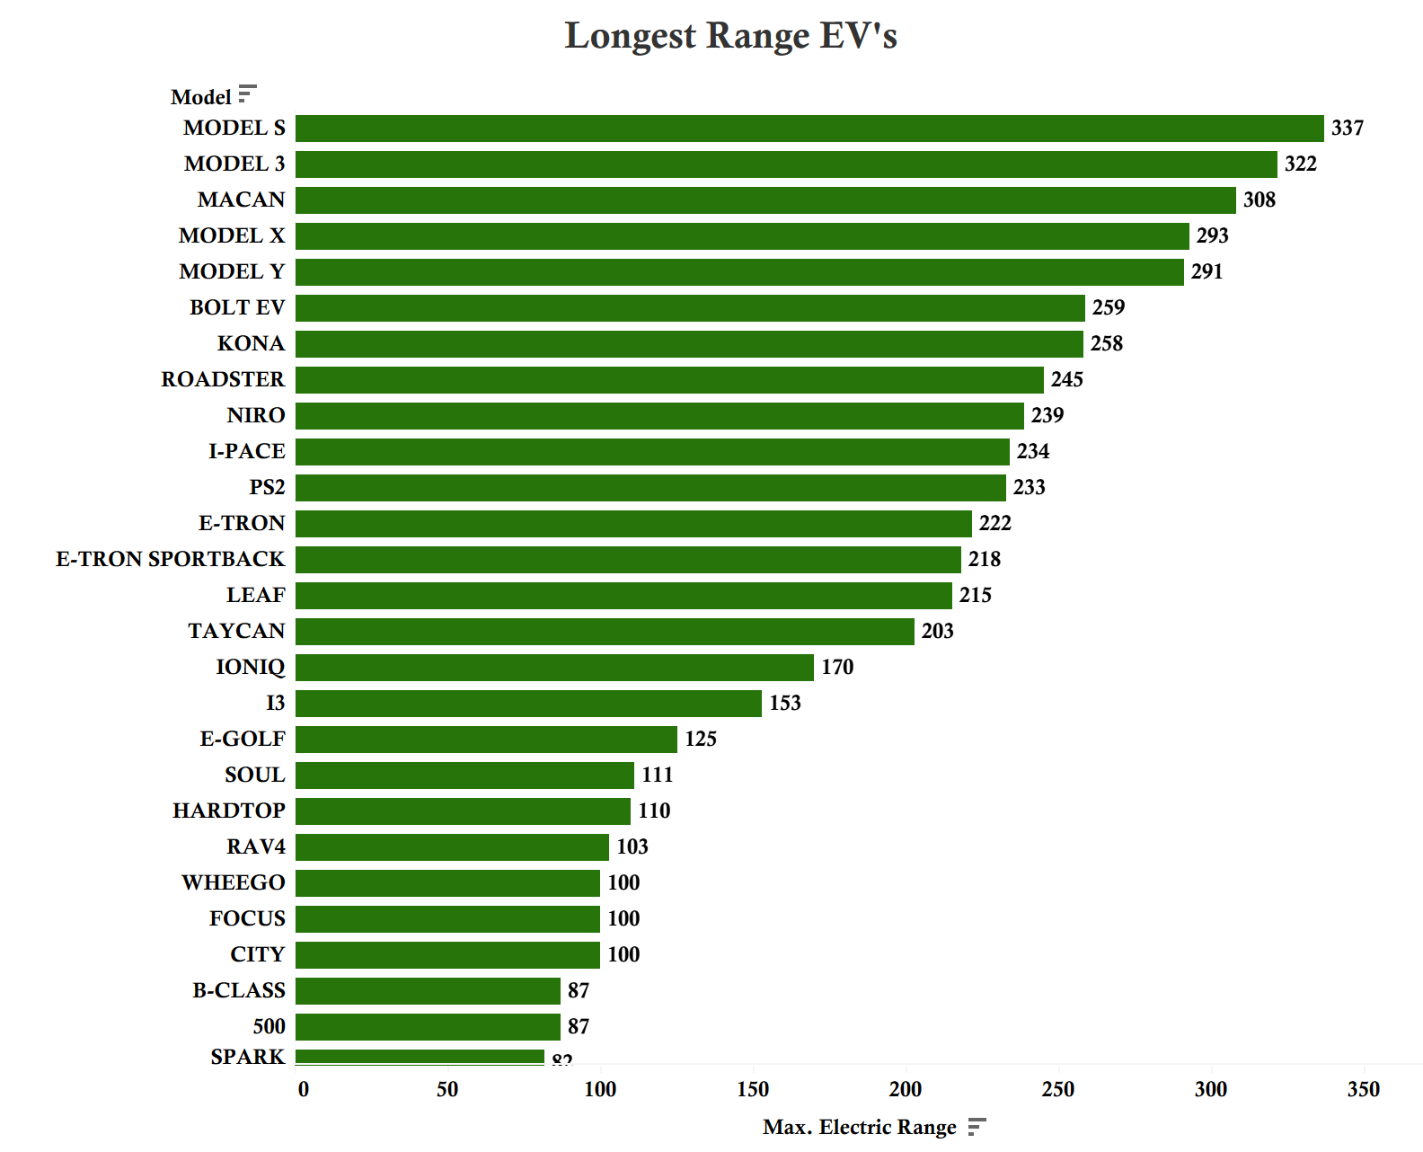
Electric Range (in miles)
Tesla vehicles consistently offer the highest electric range, often exceeding 300 miles per charge.
Hybrids vehicles typically offer much shorter electric ranges, relying on gasoline for extended trips.
For drivers with range anxiety Tesla’s are the top choice

Slide 14
Recommendations
Improve Charging Infrastructure
Prioritize underserved counties with limited access
Working with smaller utilities to install fast charging stations in remote and colder regions
Boost Public Awareness
Run targeted campaigns on EV benefits like cost savings and CAFV eligibility
Partner with local governments and community groups to build trust and visibility
Leverage Policy Incentives
Clarify CAFV eligibility to reduce “unknown” classifications
Promote state and federal incentives more effectively to drive adoption
Support High Performing Regions
Strengthen infrastructure in urban counties to sustain momentum
Benchmark these regions as markers for ideal growth
Data Backed Investments
Give resources to counties with the largest adoption gaps
Track EV growth trends continuously and adjust strategies as needed

Slide 15

Key cleaning steps: Filtered to Washington State (WA)
Removed 'State' and ‘2020 census’ columns
Handled missing values by filtering above 1
Corrected data types for Model Year, 'Electric Range', 'Base MSRP’ to numerical.
Split utility providers by delimiter of |
Data Overview
Source:
Washington State Electric Vehicle Population Data
Initial rows 264,269
Cleaned rows 263,969

Slide 16
Thank You For Listening
Done By:
Yusuf Aldamami
Fellow of the DABPT10-BH cohort

